Slide 1
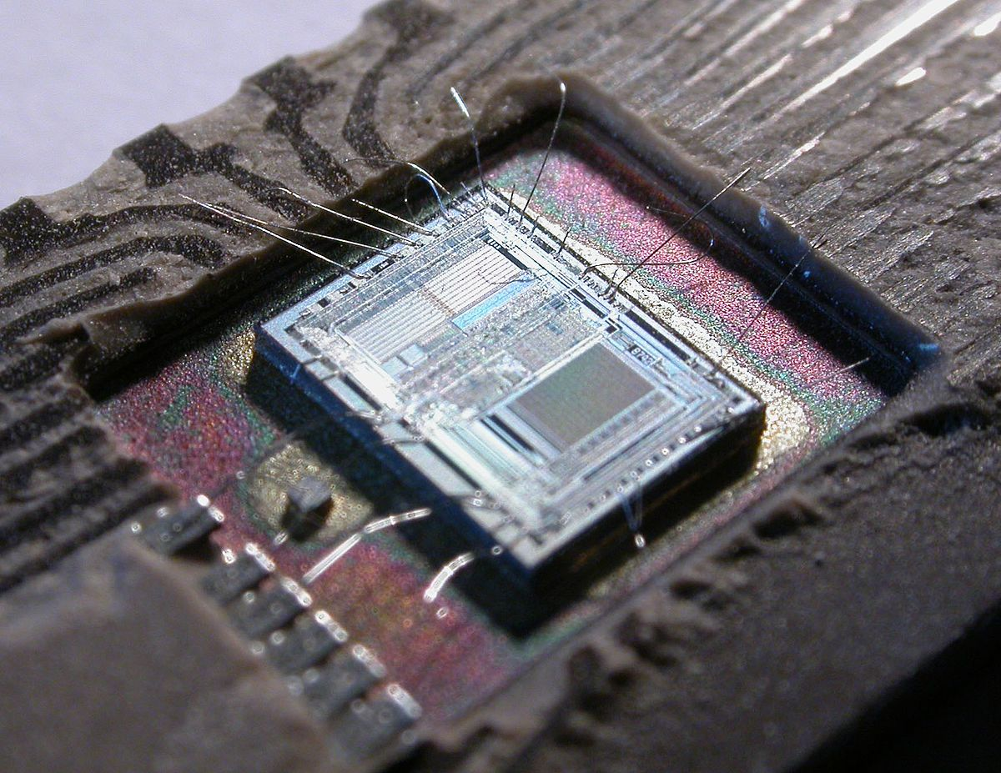
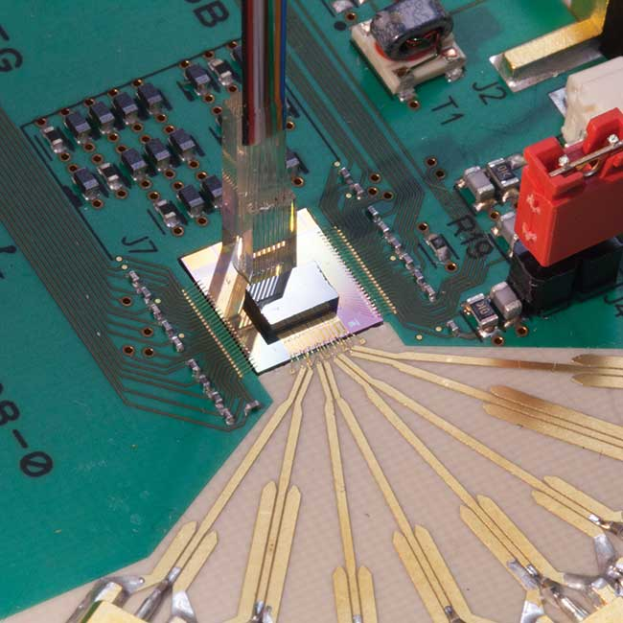
Electronics 20th → Photonics 21st
Electrical wire
Optical fiber
(Electronic) Integrated Circuit IC
Photonic Integrated Circuit PIC
February, 2021

Slide 2
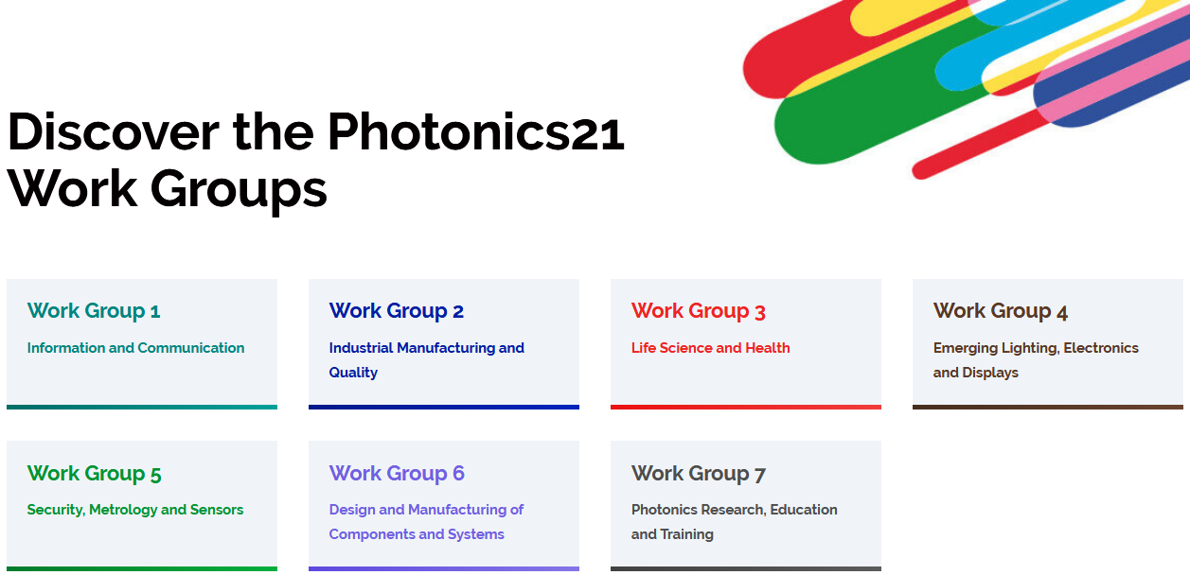
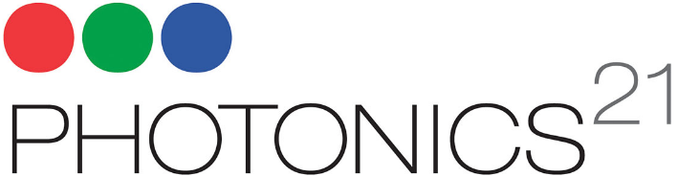
Photonics – Enabling Technology of the 21st Century
Materials → Components → Devices → Systems
Crosscutting Through a Huge Variety of Applications
www.photonics21.org

Slide 3


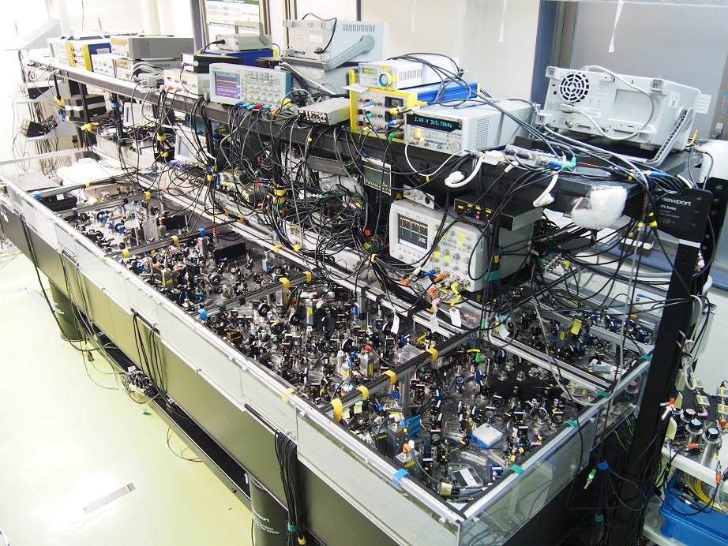
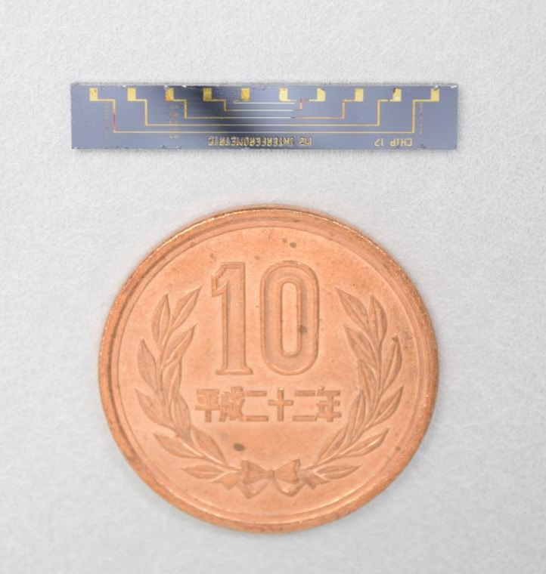
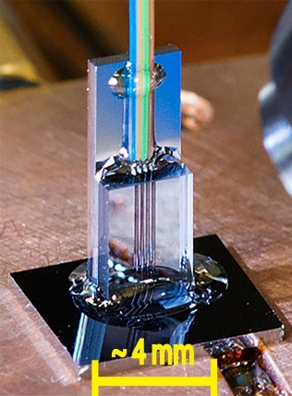

Why Integrated Photonics?
Traditional discrete optics is nice, but not well
scalable to complex systems and too expensive
Onboard systems
Communication
Quantum tech
Space systems
Sensors
Experimental setup for quantum teleportation and its PIC version at the University of Bristol
phys.org/news/2015-04-quantum-teleportation-chip.html
Data centers

Slide 4

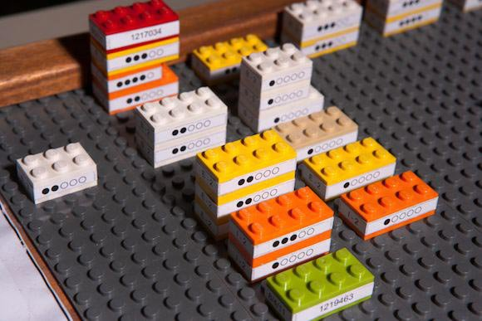
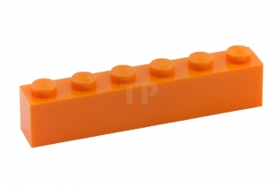
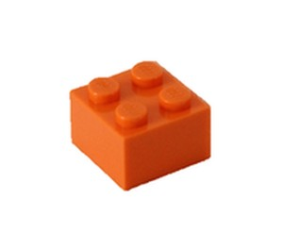

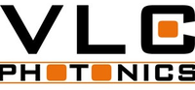

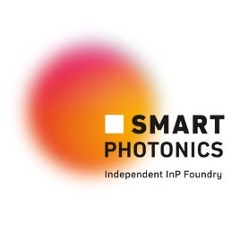










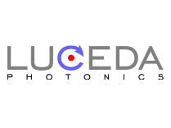


Design
Nanofab
Problem:
How to transfer virtual model to
real PIC fabrication
Model
Gap
Fabricate
Solution:
Start from PDK-library of BBB for specific nanofab technology
Process Design Kit PDK
Basic Building Blocks (BBB)
Photonic Integrated Circuits
Technology
Few Commercial Design Houses
Lots of Commercial Nanofabs
Several Commercial Software
NO Commercial Photonic Design Houses
Few Potential Commercial Nanofabs
NO Commercial Software
World
Russia
TiRphotonics

Slide 5
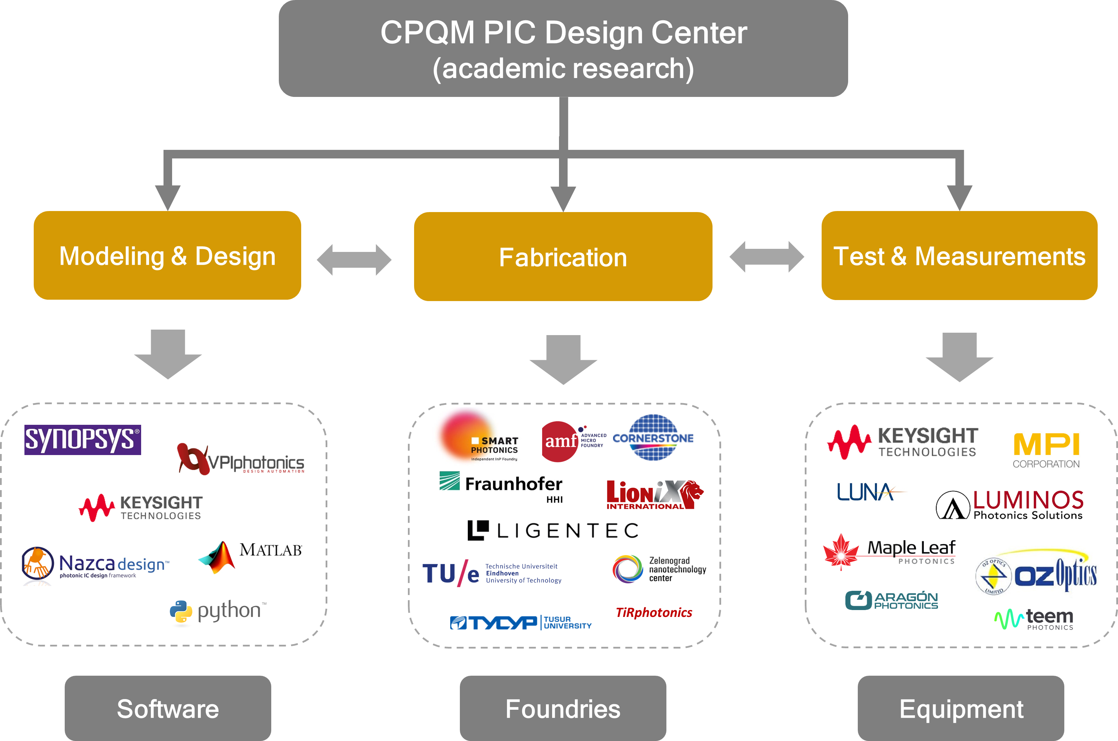
CPQM PIC Design Center: Ecosystem

Slide 6
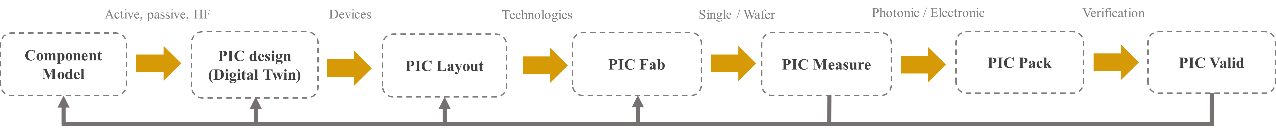
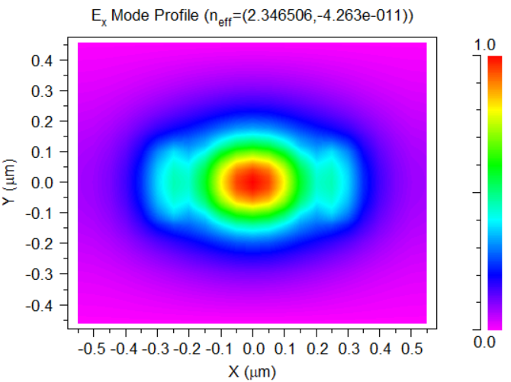
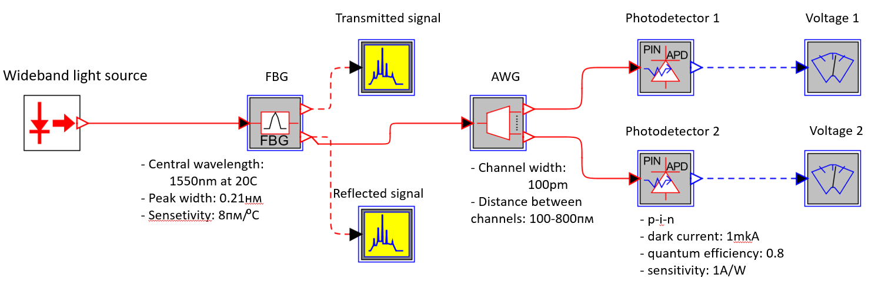
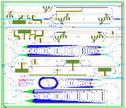
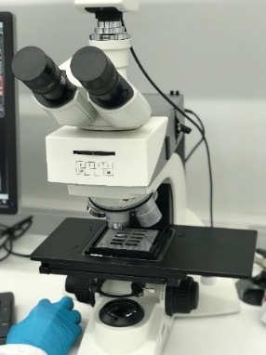
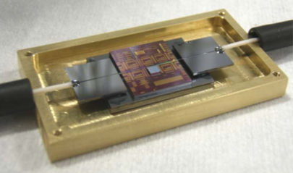
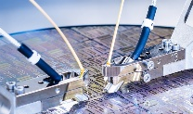
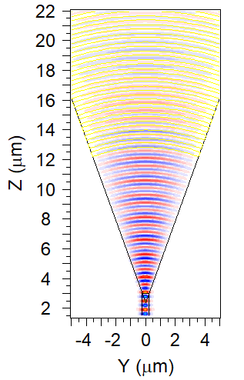
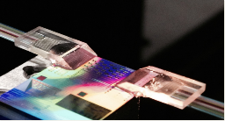
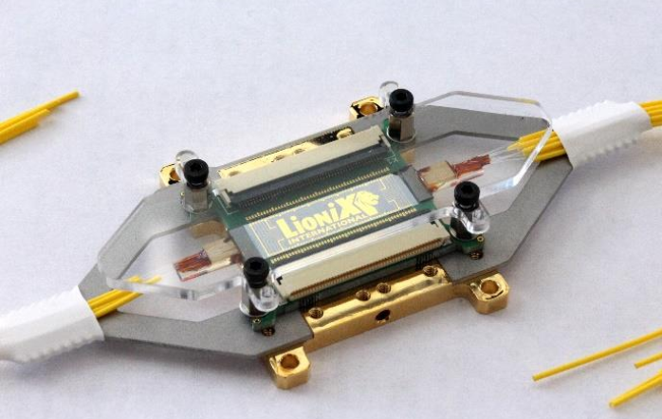
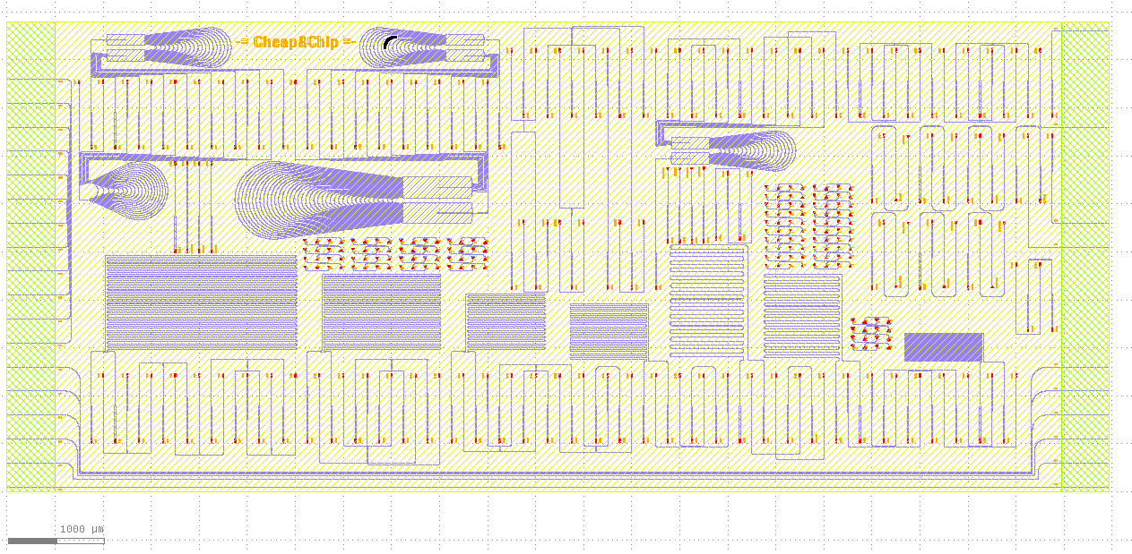
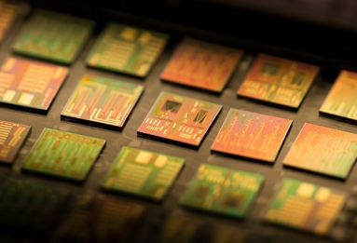
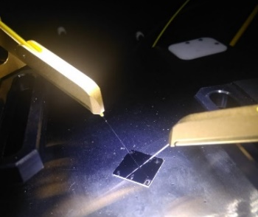
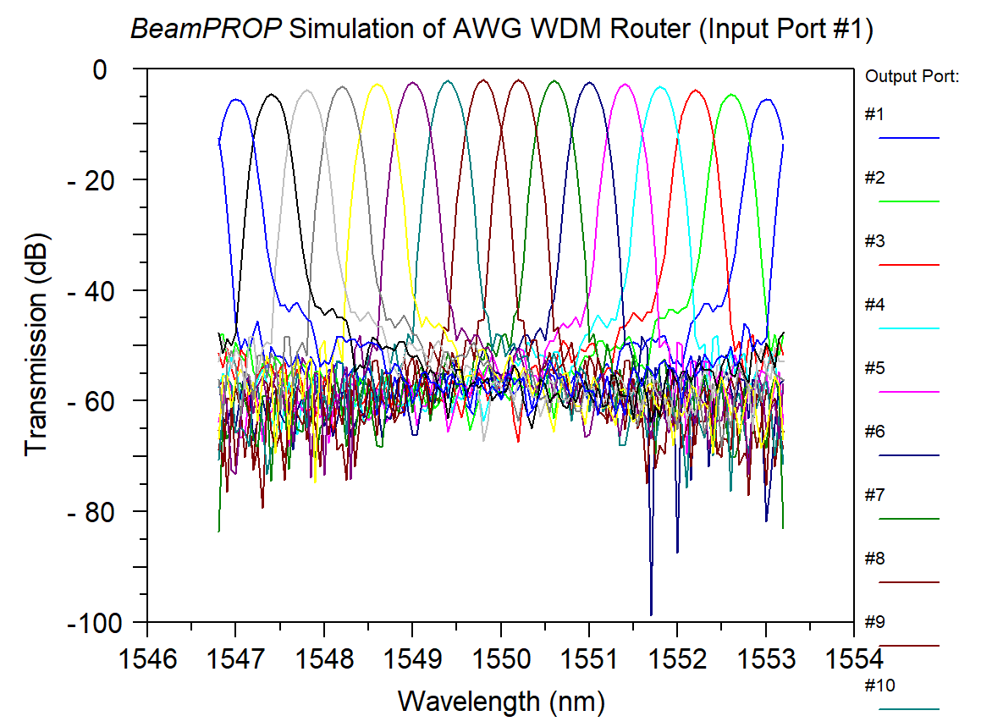
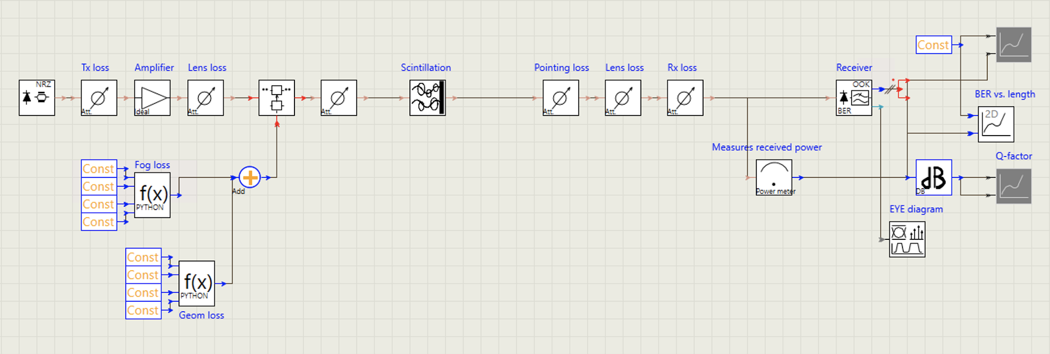
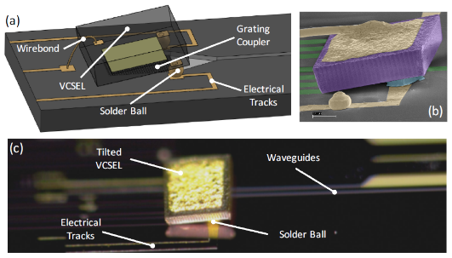
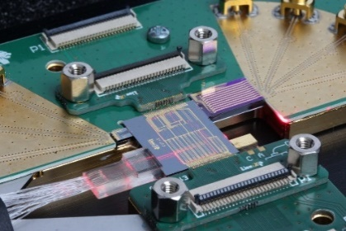
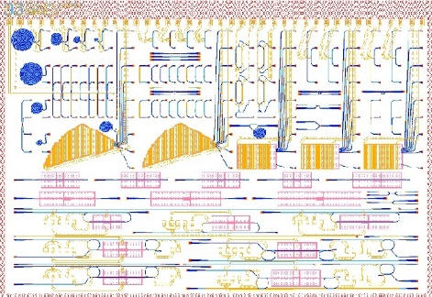
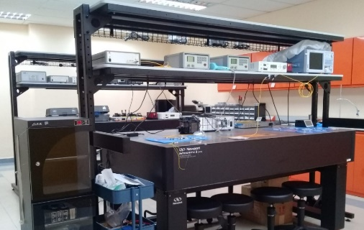
CPQM PIC Design Center: PIC flow
BBB
CBB
PIC
CPQM
CPQM, Interrogator
CPQM, SMARTphotonics, InP
SOI Wafer, Cornerstone
CPQM, PIC measurement
PIXapp, Tyndal
Automated testbed, Jeppix
CPQM, MZM
CPQM, Cornerstone, SOI
InP PICs, InPulse
CPQM, FSO system
Cornerstone
CPQM, IMOS, InP/Si
CPQM, Cornerstone

